Slide 1
UFCFVK-15-2 Internet of Things

Slide 2
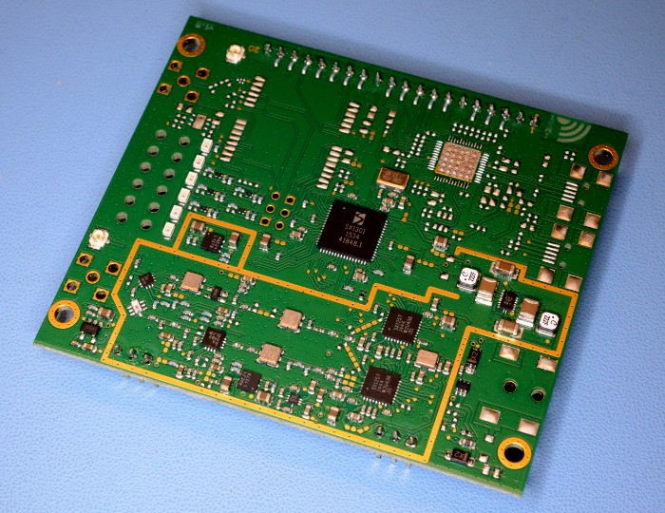
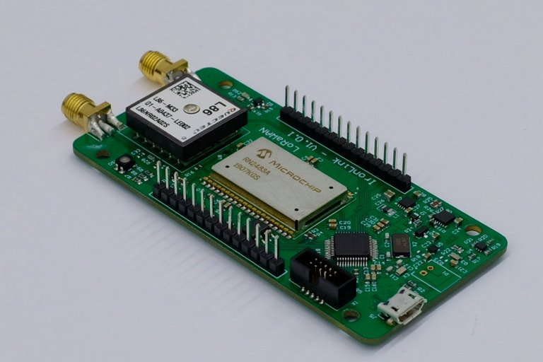
LoRaWAN – Long Range Wide Area Network
Open Standard – MAC layer can be integrated into any hardware.
Handles configuration of the network e.g. Frequency and data rate.
Hardware is generally low-cost and robust.

Slide 3
IoT solutions starts with central sending devices
Every sensor need network to communicate
LoRa enable sensor and gateway to send and receive data over long distance with enabling low power secured by scalable internationally recognized standard
116 network operations globally
5 billion end points
Customers to deploy their network easily wherever they need
Latest is monitoring water system like floods and environment regulations
200 million devices uses LoRa tech, data packets 0.3 kbps to 27 kbps
Gateway handles hundreds of devices at same time
LoRa a radio module with antenna
Microprocessor to process sensor data

Slide 4
LoRa with sensor and transceiver they are called as mote
Gateway two parts antenna and microprocessor
Gateway mains are powered and connected to the internet
Gateway can listen multiple frequency, each spreading factor at each frequency
Gateway explain the sending and receiving of data between end nodes and application server.

Slide 5
LoRaWAN does not support direct connections between end nodes.
LoRaWAN radio does not have GitHub repository for radio libraries, but several people have cloned the GitHub radio libraries.

Slide 6
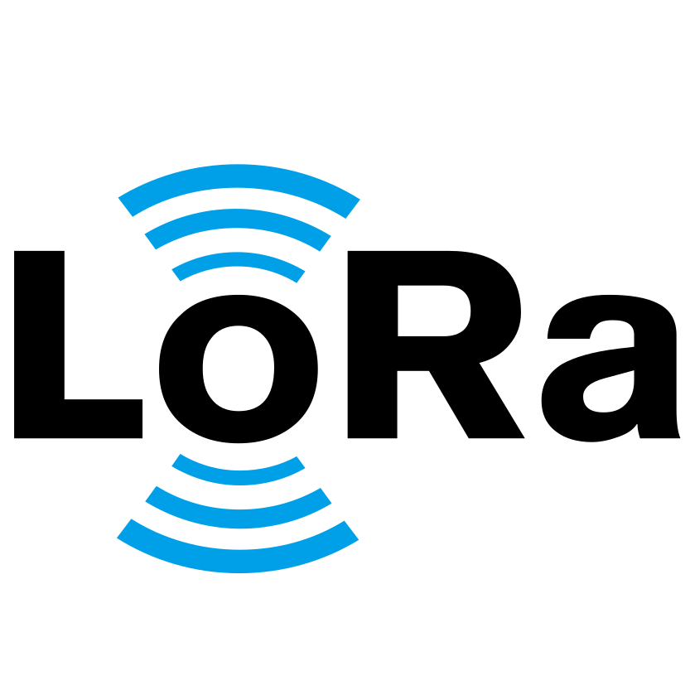
What is LoRa?
Frequency: 868Mhz, 915Mhz
Long Range
5 – 15 km
Low Data Rate
Max 27 kbps
Used to send small data packets

Slide 7
Device SX1276
Tx 20 dBm (decibel milli watts) output power
Consume power 102 milliamps for transmission of data
To receive data will consume 14 milliamps
Transmitting data in every 5 seconds
Then will listen to receive data
Then will sleep for 5 seconds
After sleep mode open-up short receive window to see of data is back from network

Slide 8
Device SX1262
Tx 20 dBm (decibel milli watts) output power
Consume power 80 milliamps for transmission of data
To receive data will consume 5 milliamps
Reduced less than 50% of energy consumption

Slide 9
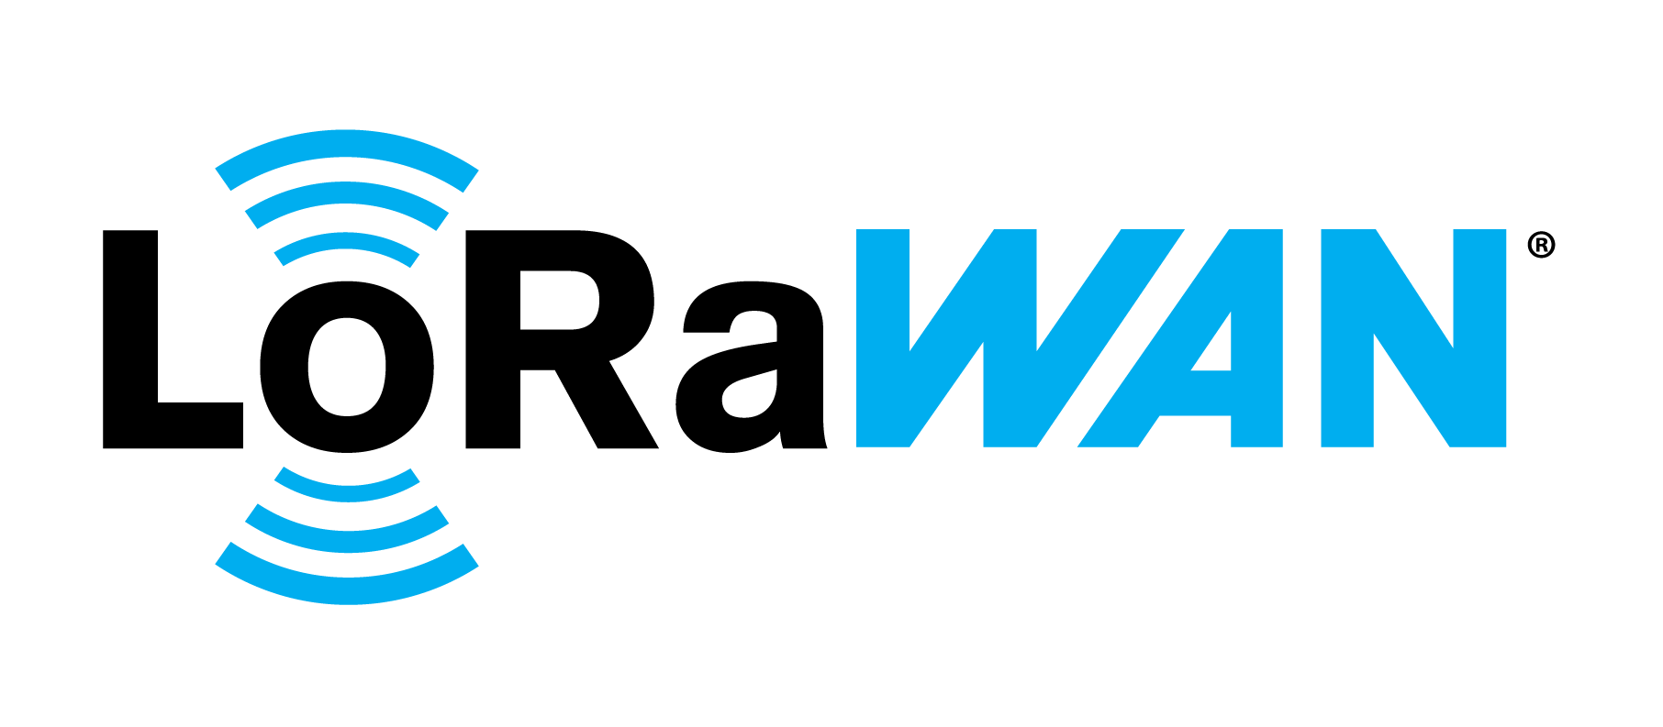
What is LoRaWAN?
Handles Transactions (e.g. Frequency, Spreading Factor, Timing)
Multiple Access
Device Authorization
Provides a minimal MAC layer that can run on most devices.

Slide 10
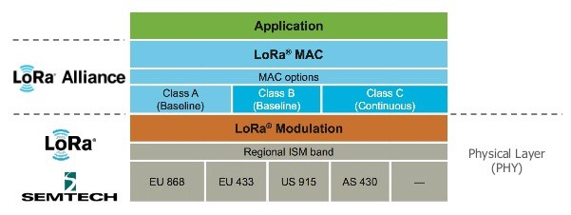
The WAN Stack
Class A – TX window at any time / Scheduled RX Window after RX
Class B – Has additional scheduled RX windows
Class C – Can TX and RX at any time

Slide 11
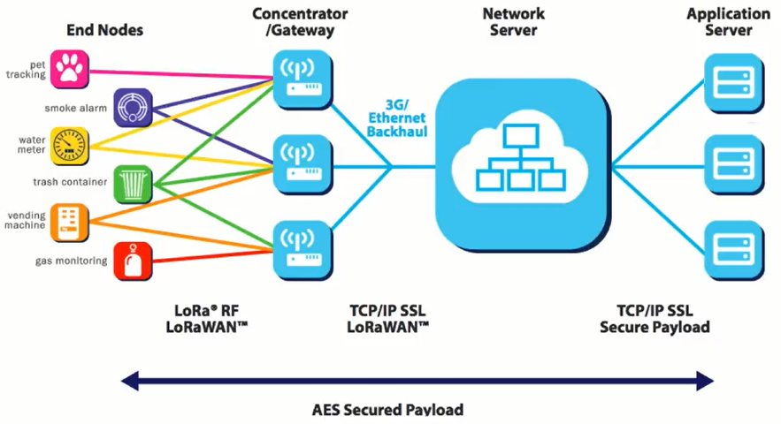

Slide 12
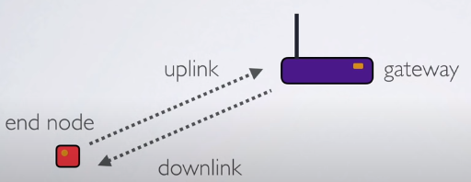

Slide 13
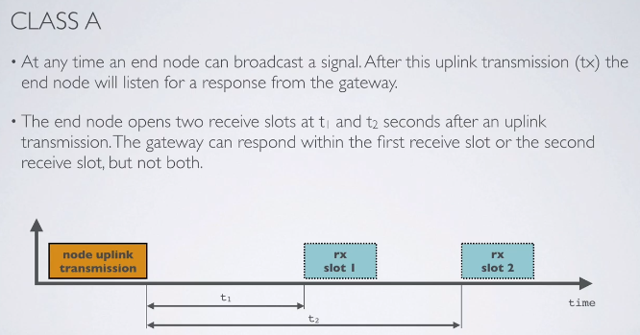

Slide 14
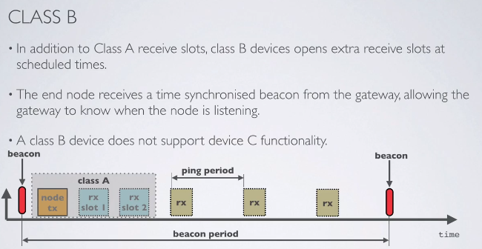

Slide 15
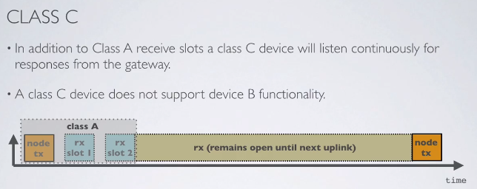

Slide 16
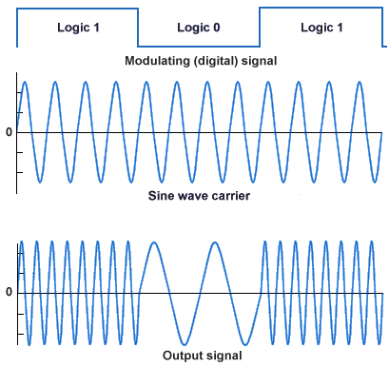
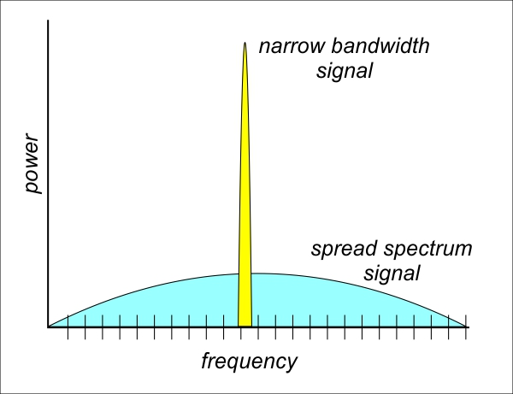
Radio Communications - Narrowband

Slide 17
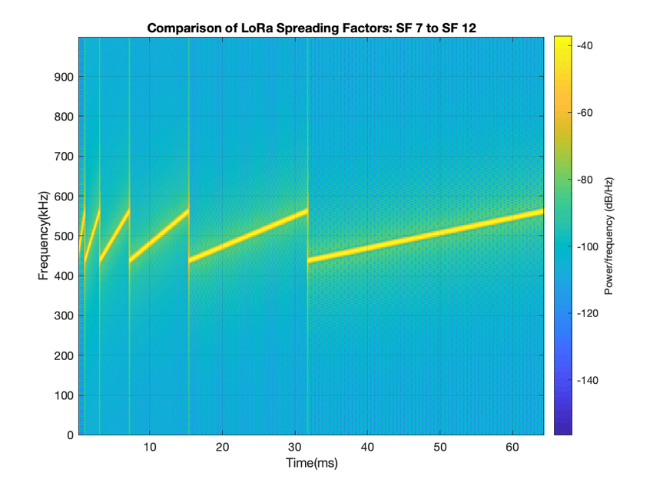
CSS (Chirp Spread Spectrum)
Symbols are encoded and up-chips or down-chips.
Chips increase and decrease over time.
Spread factor determines the amount of air time used when transmitting a symbol.

Slide 18

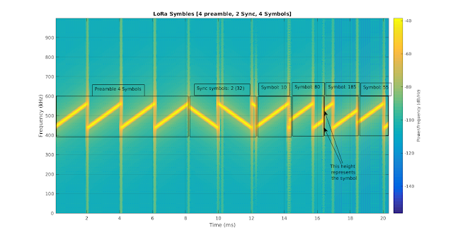
CSS – Packet Structure

Slide 19
CRC Example

Slide 20
Sender side
1
2
Data bits
1 1 0 0 1
0
2
1
1
Key bits
1 0 0 1
1
1
0
0
1
0
1
0
0
1
1
0
0
1
1
1
0
0
1
0
0
1
1
Cannot subtract 1 from 0
1
0
0
1
Borrow from left bit
Omit the left most bit
0
0
1
1
1
left bit is also 0
0
0
0
0
Since left bit is also 0
Omit the left most bit
0
1
1
1
The 2nd bit tries to borrow from the 3rd bit which is 1
3rd bit which is 1 will become 0
Now the 2nd bit will hold 10 the decimal equivalent is 2
From decimal 2, the 0 bit on the right most bit borrow decimal 1.
Now the 2nd bit will hold decimal 1.
right most bit has become decimal 2.
Data + remainder gives the code-word to be sent is
1
1
0
0
1
1
1
1
Subtract 1 from 2 will give 1.
Subtract 0 from 1 will give 1
3rd bit which will hold 0 now. Subtract 0 from 0 will give 0
4th bit which will hold 1. Subtract 1 from 1 will give 0

Slide 21
Receiver side
1
0
1
1
1
1
0
0
1
1
1
0
0
1
1
1
1
1
0
0
1
0
0
1
1
1
0
0
0
0
0
1
1
1
1
1
0
0
1
0
1
1
0
1
1
0
0
1
0
0
1
0
1
1
0
0
1
0
0
0
0
Since it’s all zero’s, received data is error free

Slide 22
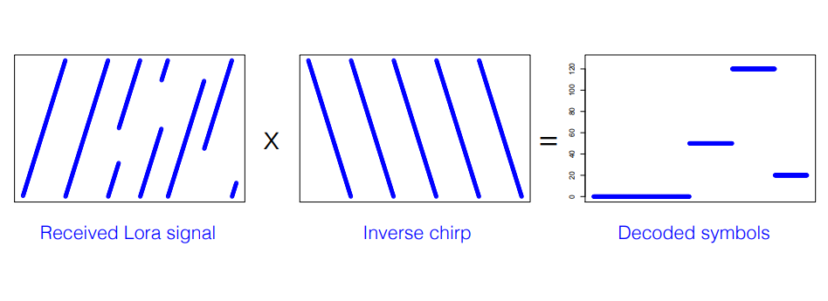
CSS – Symbols

Slide 23
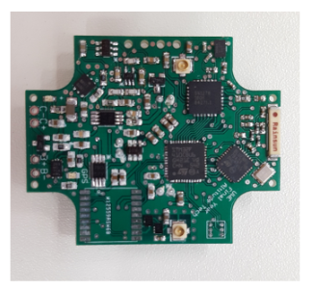
LoRa in the IoT
LoRa Radio Module
Bluetooth Radio
MCU & Baseband Processor

Slide 24
LoRa in the IoT
LoRa Radio & Baseband
Dedicated Application MCU

Slide 25
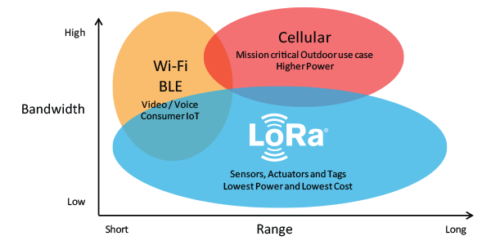
Why LoRa?
Many sensors only need to transmit a few bytes of data.
Large numbers of sensors may cover a large area, LoRa reduces network setup costs.

Slide 26
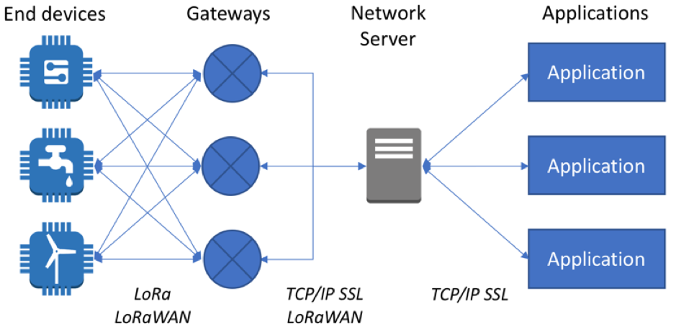
Why LoRa?
Processing power limits
Power constraints
Cost constraints

